Slide 1
IPL AUCTION STRATEGY 2021

Slide 2
Project introduction
In this project, we going going to get the efficient players for our IPL team by using Postgre SQL Database and SQL queries for retrieve the data to get the best of 11 players.

Slide 3
Players sub-Groups
BATTERS
AGGRESSIVE BATTERS,
ANCHOR BATTERS,
HARD-HITTERS
BOWLERS
ECONOMIC BOWLERS ,
WICKET - TAKING BOWLERS
ALL-ROUNDERS
BATTING ALL-ROUNDERS,
BOWLING ALL-ROUNDERS
WICKET-KEEPERS
BATTING WICKET-KEEPERS

Slide 4
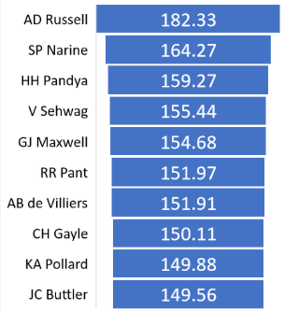
1.AGGRESSIVE BATTERS
STATEMENTS :
Aggressive batsmen:
These batsmen play aggressively and look to score runs quickly by taking risks and hitting shots all around the ground. They are important because they can provide a fast start to the team ' s innings and put pressure on the opposition ' s bowlers. This can set the tone for the rest of the innings and give the team a good platform to build on.
Your first priority is to get 2-3 players with high S.R who have faced at least 500 balls.And to do that you have to make a list of 10 players you want to bid in the auction so that when you try to grab them in auction you should not pay the amount greater than you have in the purse for a particular player.
Top 10 batters with highest strike rate
Priority Players
AD Russell
SP Narine
HH Pandya

Slide 5
SQL QUERY
select player_name, batting_strike_rate, total_batsman_runs, total_balls_faced,average, total_boundaries_count, total_boundary_runs, boundary_percentage from batsmen_data WHERE total_balls_faced >= 500 order by batting_strike_rate desc limit 10;

Slide 6
2.ANCHOR BATTERS
STATEMENTS :
Consistency: Players with a good average are generally more consistent performers, which is crucial in a format where a single player can have a big impact on the outcome of the game.
Ability to score runs quickly: Players with a good average are often capable of scoring runs quickly, which is important in a format where teams are looking to score as many runs as possible in a limited amount of time.
Ability to build partnerships: Players with a good average are also generally good at building partnerships and helping the team score consistently throughout the innings.
Ability to absorb pressure: Players with a good average are often able to absorb pressure and perform well under challenging circumstances, which is important in a format where there is always a lot of pressure on the batsmen. Now you need to get 2-3 players with good Average who have played more than 2 ipl seasons. And to do that you have to make a list of 10 players you want to bid in the auction .
# Batting Average = Total runs scored/Number of times batsman has been dismissed

Slide 7
SQL QUERY
select player_name, total_season_played, total_matches, total_singles, total_doubles ,
Average
from batsmen_data WHERE total_season_played > 2 order by average desc limit 10;

Slide 8
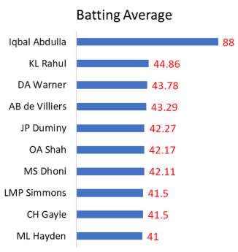
Priority Players
Iqbal Abdulla
KL Rahul
DA Warner

Slide 9
3.HARD-HITTERS & FINISHERS
STATEMENTS :
Change the momentum of the game: Hard-hitters have the ability to hit the ball a long way and score runs quickly, which can help to change the momentum of the game in their team ' s favor.
Apply pressure on the opposition: Hard-hitters can put pressure on the opposition ' s bowlers by scoring runs quickly and forcing them to bowl to their strengths.
Score big runs in the death overs: Hard-hitters are particularly valuable in the death overs, when teams are looking to score as many runs as possible. They have the ability to hit big shots and help the team post a challenging total or chase down a target.
Finishers: These batsmen come in to bat towards the end of the innings and look to hit big shots to help the team achieve a challenging total or chase down a target. They are crucial in the closing stages of the game because they have the ability to score runs quickly and take the pressure off the other batsmen. Now you need to get 2-3 Hard-hitting players who have scored most runs in boundaries and have played more the 2 ipl season.
To do that you have to make a list of 10 players you want to bid in the auction so that when you try to grab them in auction you should not pay the amount greater than you have in the purse for a particular player

Slide 10
SQL QUERY
select player_name,boundary_percentage, total_season_played,total_boundary_runs, total_death_over_runs_inn2, total_death_over_runs from batsmen_data where total_season_played > 2 and coalesce(Total_death_over_runs_inn2, 0) > 0 order by boundary_percentage desc, coalesce(total_death_over_runs_inn2, 0) desc limit 10;

Slide 11
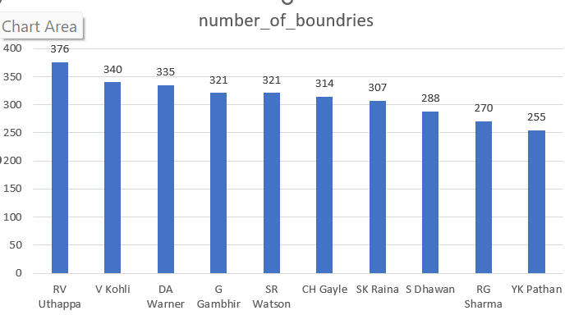
3.HARD-HITTERS & FINISHERS
Priority Players
RV Uthappa
V Kohli
DA Warner

Slide 12
1.ECONOMIC BOWLERS
STATEMENTS :
Economical bowlers are important in T20 cricket because of their ability to control the run rate, force the batsmen to take risks, create pressure on the opposition, and help the team defend a low total.
Talking about the bowlers tally In cricket, a bowler ' s tally includes all of the deliveries that they have bowled, regardless of whether they have resulted in a wicket or not.
This includes legitimate balls (which are bowled in accordance with the rules of the game), as well as no balls (which are illegal deliveries) and wides (which are balls that are too wide or high to be hit by the batsman).
Your first priority is to get 2-3 bowlers with good economy who have bowled at least 500 balls in IPL so far. To do that you have to make a list of 10 players

Slide 13
SQL QUERY
select player_name, economy, total_balls, total_overs_bowled, bowlers_extras_count from bowlers_data where total_balls >= 500 order by economy limit 10;

Slide 14
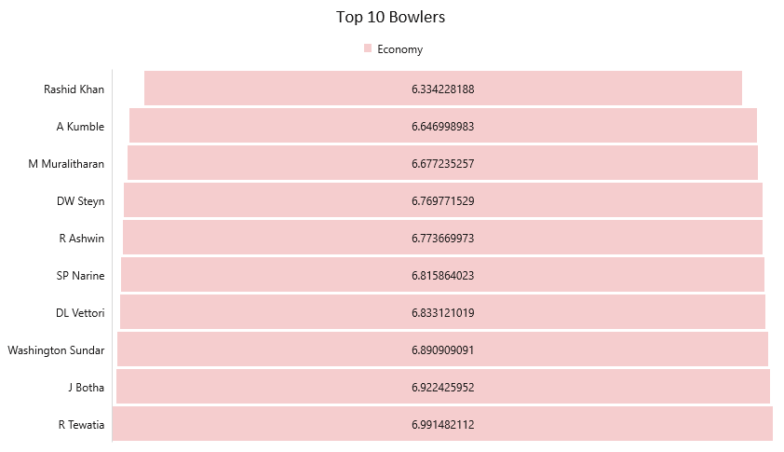
Priority Players
Rashid Khan
A Kumble
M Muralitharan

Slide 15
2.WICKET-TAKING BOWLERS
STATEMENTS :
Wicket-taking bowlers have the ability to take wickets and break partnerships, which can be crucial in a format where a single player can have a big impact on the outcome of the game.
Role in building a strong team: Wicket-taking bowlers are also an important part of building a strong team in the IPL, as they provide the team with a valuable wicket-taking option and help to balance the team ' s attack.
In order to be successful in the IPL, teams need to have a good mix of bowlers who can take wickets, as well as bowlers who can maintain a good level of control and restrict the opposition ' s scoring.
Now you need to get 2-3 bowlers with the best strike rate and who have bowled at least 500 balls in IPL so far. To do that you have to make a list of 10 players

Slide 16
SQL QUERY
select player_name, bowling_strike_rate, total_balls,total_wickets, total_overs_bowled, total_matches,economy from bowlers_data where total_balls >= 500 order by bowling_strike_rate limit 10;

Slide 17

PRIORITY PLAYERS
K Rabada
DE Bolinger
AJ Tye

Slide 18
1.ALL-ROUNDER(BATTING)
One of the main ways that all-rounders can contribute in T20 cricket is by scoring runs quickly and effectively.
In T20 cricket, teams often need to score runs at a fast pace, and all-rounders who can hit the ball hard and rotate the strike are valuable assets. They can also provide a steadying influence if the team is under pressure, as they have the experience and skills to build an innings.
Now you need to get 2-3 All rounders with the best batting as well as bowling strike rate and who have faced at least 500 balls in IPL so far and have bowled minimum 300 balls.
To do that you have to make a list of 10 players In My Perspective All-Rounders are classified as Two Categories

Slide 19
SQL QUERY
Create table all_rounder AS (SELECT Batsmen_data.Player_name,Batsmen_data.batting_strike_rate, Batsmen_data.average,Batsmen_data.total_balls_faced, Bowlers_data.bowling_strike_rate,Bowlers_data.total_balls, Bowlers_data.economy FROM Batsmen_data INNER JOIN Bowlers_data ON Batsmen_data.Player_name = Bowlers_data.Player_name);
--Selecting Batting All-Rounder
SELECT * FROM all_rounder WHERE Total_balls >= 300 and total_balls_faced >= 500 ORDER BY Batting_strike_rate DESC,bowling_strike_rate ASC LIMIT 10;

Slide 20
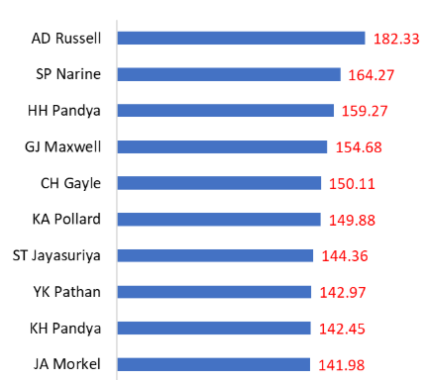
ALL ROUNDERS BATTING STRIKE RATE
PRIORITY PLAYER
AD RUSSELL
SP Narine
HH PANDYA

Slide 21
1.ALL-ROUNDER(BOWLING)
All-rounders are also valuable because they can bowl effectively in different situations.
In T20 cricket, teams often have to make quick adjustments to their game plan, and all-rounders who can bowl a variety of deliveries and execute their skills under pressure can be very useful.
They can bowl in the powerplay, in the middle overs, or at the death, and they can be used to exploit the opposition ' s weaknesses or contain the scoring.
Now you need to get 2-3 All_rounders with the best batting as well as bowling strike rate and who have faced at least 500 balls in IPL so far and have bowled minimum 300 balls.
To do that you have to make a list of 10 players. In My Perspective All-Rounders are classified as Two Categories

Slide 22
SQL QUERY
CREATE TABLE all_rounder AS (SELECT Batsmen_data.Player_name,Batsmen_data.batting_strike_rate, Batsmen_data.average,Batsmen_data.total_balls_faced, Bowlers_data.bowling_strike_rate,Bowlers_data.total_balls, Bowlers_data.economy FROM Batsmen_data INNER JOIN Bowlers_data ON Batsmen_data.Player_name = Bowlers_data.Player_name);
--Selecting Bowling All-Rounder
SELECT * FROM all_rounder WHERE Total_balls >= 300 and total_balls_faced >= 500 ORDER BY bowling_strike_rate ASC,batting_strike_rate DESC LIMIT 10;

Slide 23
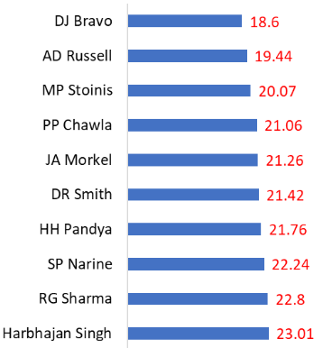
ALL ROUNDERS BOWLING STRIKE RATE
PRIORITY PLAYERS
DJ Bravo
AD Russell
MP Stoinis

Slide 24
WICKET KEEPERS
STATEMENTS :
In T20 cricket, the role of the wicketkeeper is slightly different from that in longer forms of the game.
In T20, the emphasis is on scoring runs quickly, so the wicketkeeper is often expected to contribute to the team ' s run total with aggressive batting.
They may also be called upon to bowl a few overs of spin or medium pace. Defensively, the wicketkeeper still has an important role to play, as they are responsible for catching and stumping the batsman.
In T20 cricket, where every run and wicket is crucial, a good wicket keeper can make a big difference to the team ' s chances of winning.

Slide 25
SQL QUERY
--Creating Wicket Keepers Data Table
CREATE TABLE Wicket_Keepers AS (SELECT DISTINCT Batsmen_data.Player_name, Batsmen_data.Batting_strike_rate, Batsmen_data.Total_Batsman_runs, Batsmen_data.Total_balls_faced, Batsmen_data.Average, Batsmen_data.Total_boundaries_count, Batsmen_data.Total_boundary_runs, Batsmen_data.Boundary_percentage FROM Batsmen_data INNER JOIN IPL_data ON Batsmen_data.Player_name = IPL_data.Fielder WHERE Batsmen_data.Total_balls_faced >= 500 AND IPL_data.dismissal_kind = 'stumped’);
--Selecting Aggressive Wicket Keeper Batsmen SELECT * FROM Wicket_Keepers ORDER BY Batting_strike_rate DESC LIMIT 10;

Slide 26
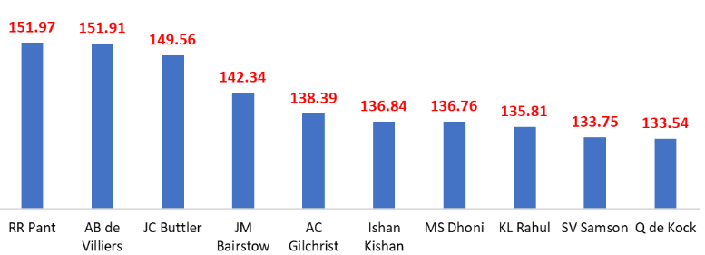
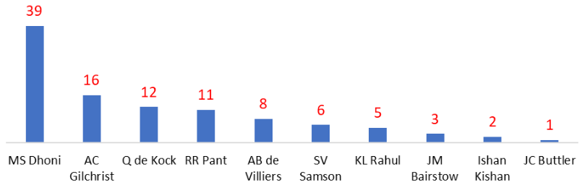
WICKET KEEPER BATTING STRIKE RATE
PRIORITY PLAYERS
MS Dhoni
WICKET KEEPER STUMPING COUNTS
AC Gilchrist
RR Pant
Click here to get data IPL Dataset.zip

Slide 27
THANK YOU

